Slide 1
MAJOR PROJECT SYNOPSIS
Defenses Against Adversarial Images
SUBMITTED BY:
DEEPAK KUMAR (00696502717)
DEEPAK KUMAR RAI (00796502717)
JNANESHWAR (01096502717)
MANTHAN SINGH (01396502717)

Slide 2
The Problem Statement
Using adversarial images, we can trick our Convolutional Neural Networks (CNNs) into making incorrect predictions. While, according to the human eye, adversarial images may look identical to their original counterparts, they contain small perturbations that cause our CNNs to make wildly incorrect predictions.
For example, imagine a deep neural network deployed to a self-driving car. Nefarious users could generate adversarial images, print them, and then apply them to the road, signs, overpasses, etc., which would result in the model thinking there were pedestrians, cars, or obstacles when there are, in fact, none! The result could be disastrous, including car accidents, injuries, and loss of life.

Slide 3
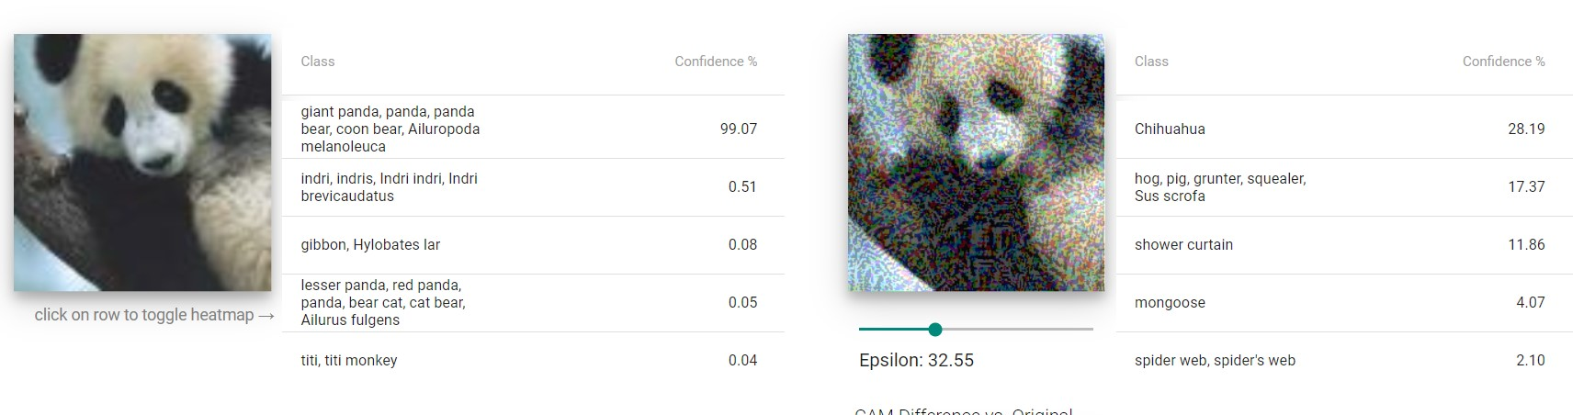
An Example

Slide 4
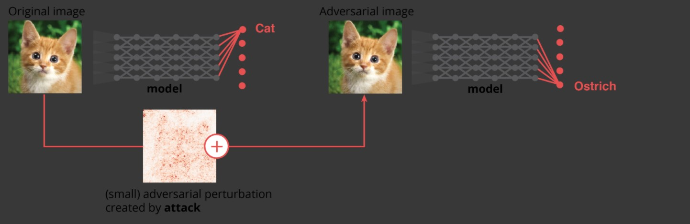
Another Example

Slide 5
Why does this matter?
Computer vision is used everywhere!
Facial Recognition
Self Driving Cars (change speed limit sign) https://arxiv.org/pdf/1511.07528.pdf
Biometric Recognition
Text Applications too! (Think CNNs for Sentiment Analysis or Text classification)
Ad-blockers can incorrectly classify ads https://arxiv.org/pdf/1811.03194.pdf
Spam Classifiers can incorrectly identify malicious mails https://www.covert.io/research-papers/deep-learning-security/Large-scale%20Malware%20Classification%20using%20Random%20Projections%20and%20Neural%20Networks.pdf

Slide 6
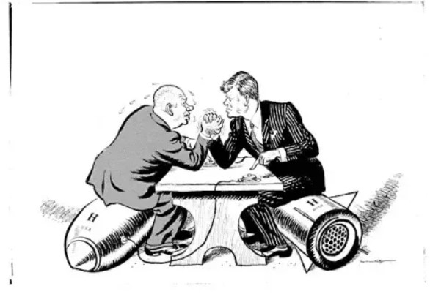
Adversarial images are an “arm race” and we need to defend against them
Defending against adversarial attacks has been and will continue to be an active research area. There is no “magic bullet” method that will make your model robust to adversarial attacks.

Slide 7
Major Type of Adversarial Attacks
1.Fast Gradient Sign Method(FGSM)
This technique adds noise (not random noise) whose direction is the same as the gradient of the cost function with respect to the data.
The noise is scaled by epsilon, which is usually constrained to be a small number via max norm.
The magnitude of gradient does not matter in this formula, but the direction (+/-).
FGSM can be implemented in Python in a few lines.

Slide 8
2.Backward Pass Differentiable Approximation(BPDA)
Attackers are very smart! They found a way to fool the FGSM.
In the game of security, both attacker and defender rely on gradient descent to learn. The gradient gives the defender information about how to improve the model; the same gradient tells the attacker how to trick the model!
Gradient masking occurs when the defender attempts to hide the gradient from the attacker, often by using a non-differentiable transform or technique like a decision tree.
If you can’t differentiate, there is no gradient for the attacker to use! A particular type of gradient masking, known as shattered gradients, makes the defense gradient either non-differentiable, non-existent, or just wrong.
This defense approach worked at first but was eventually defeated by an attack known as Backward Pass Differentiable Approximation (BPDA)

Slide 9
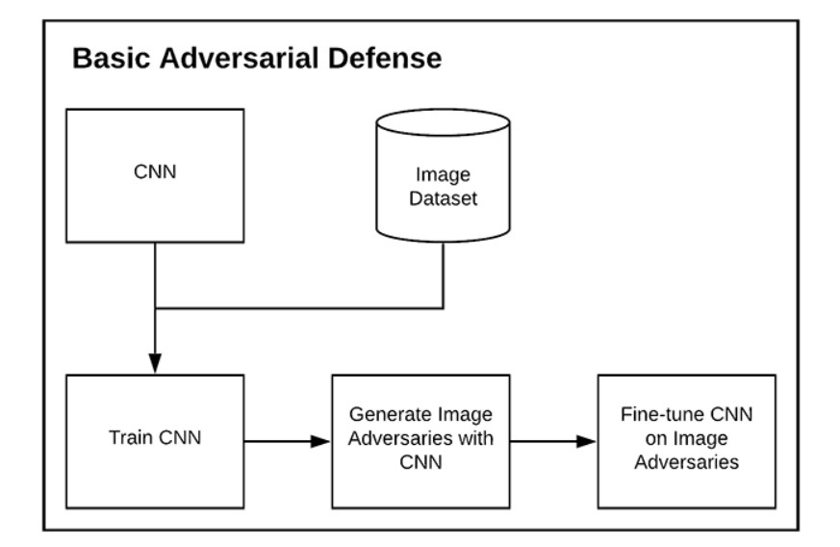
How Can You Defend Against Adversarial Image Attacks?

Slide 10
Ways To Defend Against Adversarial Attacks
Training our model on a given dataset, generating a set of adversarial images, and then fine-tuning the model on the adversarial images
Generating mixed batches of both the original training images and adversarial images, followed by fine-tuning our neural network on these mixed batches

Slide 11
Major Defenses Are?
ADVERSARIAL TRAINING
THE BARRAGE OF RANDOM TRANSFORM(BaRT)

Slide 12
Problem and Considerations with Adversarial Image Defense
Both of the adversarial image defense methods mentioned in the previous section are dependent on:
The model architecture and weights used to generate the adversarial examples
The optimizer used to generate them
These training schemes might not generalize well if we simply create an adversarial image with a different model (potentially a more complex one).Additionally, if we train only on adversarial images then the model might not perform well on the regular images. This phenomenon is often referred to as catastrophic forgetting, and in the context of adversarial defense, means that the model has “forgotten” what a real image looks like.

Slide 13
THANK YOU

